Slide 1

Multiprocessor Synchronization
CSCI 176
Spin Locks & Contention
Lecture 10,11,12
October 2024
Maurice Herlihy
Brown University

Slide 2
Focus so far: Correctness and Progress
Models
Accurate (we never lied to you)
But idealized
Protocols
Elegant
Important
But naïve
Notes:
So far we have focused on idealized models because we were interesting in understanding the foundations of the field. Understanding how to build a bakery lock isn’t all that useful if you really want to implement a lock directly, but you now know more about the underlying problems than you would if we had started looking at complicated practical techniques right away.

Slide 3
New Focus: Performance
Models
More complicated (not the same as complex!)
Still focus on principles (not soon obsolete)
Protocols
Elegant (in their fashion)
Important (why else would we pay attention)
And realistic (your mileage may vary)
Notes:
No we are going to transition over to the “real” world and look at the kinds of protocols you might actually use. These models are necessarily more complicated, in the sense of having more details and exceptions and things to remember, but not necessarily more complex, in the sense of encompassing deeper ideas. We are still going to focus on issues that are important, that is, things that matter for all kinds of platforms and applications, and avoid other optimizations that might sometimes work in practice but that don’t teach us anything.

Slide 4
Kinds of Architectures
SISD (Uniprocessor)
Single instruction stream
Single data stream
SIMD (GPU)
Single instruction
Multiple data
MIMD (Multiprocessors)
Multiple instruction
Multiple data
Notes:
You can classify processors by how they manage data and instruction streams. A single-instruction single-data stream architecture is just a uniprocessor. A few years ago, single-instruction multiple-data stream architectures were popular, for example the Connection Machine CM2. These have fallen out of favor, at least for the time being.

Slide 5
Kinds of Architectures
SISD (Uniprocessor)
Single instruction stream
Single data stream
Our space
SIMD (GPU)
Single instruction
Multiple data
MIMD (Multiprocessors)
Multiple instruction
Multiple data
Notes:
You can classify processors by how they manage data and instruction streams. A single-instruction single-data stream architecture is just a uniprocessor. A few years ago, single-instruction multiple-data stream architectures were popular, for example the Connection Machine CM2. These have fallen out of favor, at least for the time being.

Slide 6
MIMD Architectures
memory
Shared Bus
Distributed
Memory Contention
Communication Contention
Communication Latency
Notes:
There are two basic kinds of MIMD architectures. In a shared bus architecture, processors and memory are connected by a shared broadcast medium called a bus (like a tiny Ethernet). Both the processors and the memory controller can broadcast on the bus. Only one processor (or memory) can broadcast on the bus at a time, but all processors (and memory) can listen. Bus-based architectures are the most common today because they are easy to build.
The principal things that affect performance are (1) contention for the memory: not all the processors can usually get at the same memory location at the same times, and if they try, they will have to queue up, (2) contention for the communication medium. If everyone wants to communicate at the same time, or to the same processor, then the processors will have to wait for one another. Finally, there is a growing communication latency, the time it takes for a processor to communicate with memory or with another processor.

Slide 7
Today: Revisit Mutual Exclusion
Performance, not just correctness
Proper use of multiprocessor architectures
A collection of locking algorithms…
(1)
Notes:
When programming uniprocessors, one can generally ignore the exact structure
and properties of the underlying system. Unfortunately, multiprocessor
programming has yet to reach that state, and at present it is crucial that
the programmer understand the properties and limitations of the underlying
machine architecture. This will be our goal in this chapter. We revisit
the familiar mutual exclusion problem, this time with the aim of devising
mutual exclusion protocols that work well on today’s multiprocessors.

Slide 8

What Should you do if you can’t get a lock?
Keep trying
“spin” or “busy-wait”
Good if delays are short
Yield the processor
Good if delays are long
Always good on uniprocessor
our focus today
(1)
Notes:
Any mutual exclusion protocol poses the question: what do you do if you cannot acquire the lock? There are two alternatives. If you keep trying, the lock is called a spin lock, and repeatedly testing the lock is called spinning. or busy-waiting. We will use these terms interchangeably. The filter and bakery algorithms are spin-locks. Spinning is sensible when you expect the lock delay to be short. For obvious reasons, spinning makes sense only on multiprocessors. The alternative is to suspend yourself and ask the operating system's scheduler to schedule another thread on your processor, which is sometimes called blocking. Java’s built-in synchronization is blocking. Because switching from one thread to another is expensive, blocking makes sense only if you expect the lock delay to be long. Many operating systems mix both strategies, spinning for a short time and then blocking.

Slide 9
Basic Spin-Lock
lock means sequential bottleneck
.
.
CS
.
lock
critical
section
Resets lock
upon exit
Bottleneck means no parallelism
Notes:
With spin locks, synchronization usually looks like this. Some set of threads contend for the lock. One of them acquires it, and the others spin. The winner enters the critical section, does its job, and releases the lock on exit.

Slide 10
Basic Spin-Lock
Lock suffers from contention
Honk!
.
.
CS
.
spin
lock
critical
section
Resets lock
upon exit
Honk!
Notes:
With spin locks, synchronization usually looks like this. Some set of threads contend for the lock. One of them acquires it, and the others spin. The winner enters the critical section, does its job, and releases the lock on exit.

Slide 11
Test-and-Set Lock
Boolean state
Lock: Test-and-set (TAS)
Swap true with current value
Returns prior value
Unlock: write false
TAS sometimes called “getAndSet”
Notes:
The test-and-set machine instruction atomically stores true in that word, and returns that word's previous value, swapping the value true for the word's current value. You can reset the word just by writing false to it. Note in Java TAS is called getAndSet. We will use the terms interchangeably.

Slide 12
Review: Test-and-Set
public class AtomicBoolean {
boolean value;
public synchronized boolean getAndSet(boolean newValue) {
boolean prior = value;
value = newValue;
return prior;
}
}
(5)
Notes:
The test-and-set machine instruction, with consensus number two, was the principal synchronization instruction provided by many early multiprocessors.

Slide 13
Review: Test-and-Set
public class AtomicBoolean {
boolean value;
public synchronized boolean getAndSet(boolean newValue) {
boolean prior = value;
value = newValue;
return prior;
}
}
Package
java.util.concurrent.atomic
Notes:
Here we are going to build one out of the atomic Boolean class, which is provided as part of Java’s standard library of atomic primitives. You can think of this object as a box holding a Boolean value.

Slide 14
Review: Test-and-Set
public class AtomicBoolean {
boolean value;
public synchronized boolean getAndSet(boolean newValue) {
boolean prior = value;
value = newValue;
return prior;
}
}
Atomically swap old and new values
Notes:
The getAndSet method swaps a Boolean value with the current contents of the box.

Slide 15
Review: Test-and-Set
AtomicBoolean lock
= new AtomicBoolean(false)
…
boolean prior = lock.getAndSet(true)
Notes:
At first glance, the AtomicBoolean class seems ideal for implementing a spin lock.

Slide 16
Review: Test-and-Set
AtomicBoolean lock
= new AtomicBoolean(false)
…
boolean prior = lock.getAndSet(true)
Swapping in true is called “test-and-set” or TAS
(usually a HW machine instruction)
(5)
Notes:
If we call getAndSet(true), then we have a test-and-set.

Slide 17
Test-and-Set Locks
Lock is free: bit is false
Lock is taken: value is true
Spin: repeatedly call TAS
When result is false, success!
While result is true, try again
Release lock by setting bit to false
Notes:
The lock is free when the word's value is false, and busy when it is true.

Slide 18
Test-and-set Lock
class TASlock {
AtomicBoolean state =
new AtomicBoolean(false);
void lock() {
while (state.getAndSet(true)) {}
}
void unlock() {
state.set(false);
}}
Notes:
Here is what it looks like in more detail.

Slide 19
Test-and-set Lock
class TASlock {
AtomicBoolean state =
new AtomicBoolean(false);
void lock() {
while (state.getAndSet(true)) {}
}
void unlock() {
state.set(false);
}}
Lock state is AtomicBoolean
Notes:
The lock is just an AtomicBoolean initialized to false.

Slide 20
Test-and-set Lock
class TASlock {
AtomicBoolean state =
new AtomicBoolean(false);
void lock() {
while (state.getAndSet(true)) {}
}
void unlock() {
state.set(false);
}}
Keep trying until lock acquired
Notes:
The lock() method repeatedly applies test-and-set to the location until that instruction returns false (that is, until the lock is free).

Slide 21
Test-and-set Lock
class TASlock {
AtomicBoolean state =
new AtomicBoolean(false);
void lock() {
while (state.getAndSet(true)) {}
}
void unlock() {
state.set(false);
}}
Release lock by resetting state to false
Notes:
The unlock() method simply writes the value false to that word.

Slide 22
Space Complexity
TAS spin-lock has small “footprint”
n thread spin-lock uses O(1) space
As opposed to O(n) Bakery
What about the Ω(n) RW lower bound?
TAS is RMW, not RW …
Notes:
We call real world space complexity the “footprint”. By using TAS we are able to reduce the footprint from linear to constant.

Slide 23
Performance
Experiment
n threads
Increment shared counter 1 million times
How long should it take?
How long does it take?
Notes:
Let’s do an experiment on a real machine. Take n threads and have them collectively acquire a lock, increment a counter, and release the lock. Have them do it collectively, say, one million times. Before we look at any curves, let’s try to reason about how long it should take them.

Slide 24
Graph
Sequential bottleneck means no speedup
time
ideal
threads
Notes:
Ideally the curve should stay flat after that. Why? Because we have a sequential bottleneck so no matter
How many threads we add running in parallel, we will not get any speedup (remember Amdahl’s law).

Slide 25
Mystery #1
TAS lock
Ideal
time
Wait, what?
threads
Notes:
The curve for TAS lock looks like this. In fact, if you do the experiment you have to give up because it takes so long beyond a certain number of processors? What is happening? Let us try this again.

Slide 26
Test-and-Test-and-Set Locks
Spin until lock “looks” free
Continue while read returns true (lock taken)
As soon as read returns false (lock is free) …
Attack!
Call TAS to acquire lock
If TAS fails, back to spinning
Notes:
Let’s try a slightly different approach. Instead of repeatedly trying to test-and-set the lock, let’s split the locking method into two phases. In the lurking phase, we wait until the lock looks like it’s free, and when it’s free, we pounce, attempting to acquire the lock by a call to test-and-set. If we win, we’re in, if we lose, we go back to lurking.

Slide 27
Test-and-test-and-set Lock
class TTASlock {
AtomicBoolean state =
new AtomicBoolean(false);
void lock() {
while (true) {
while (state.get()) {}
if (!state.getAndSet(true))
return;
}
}
Notes:
Here is what the code looks like.

Slide 28
Test-and-test-and-set Lock
class TTASlock {
AtomicBoolean state =
new AtomicBoolean(false);
void lock() {
while (true) {
while (state.get()) {}
if (!state.getAndSet(true))
return;
}
}
Wait until lock looks free
Notes:
First we spin on the value, repeatedly reading it until it looks like the lock is free. We don’t try to modify it, we just read it.

Slide 29
Test-and-test-and-set Lock
class TTASlock {
AtomicBoolean state =
new AtomicBoolean(false);
void lock() {
while (true) {
while (state.get()) {}
if (!state.getAndSet(true))
return;
}
}
Then try to acquire it
Notes:
As soon as it looks like the lock is free, we call test-and-set to try to acquire it. If we are first and we succeed, the lock() method returns, and otherwise, if someone else got there before us, we go back to lurking, to repeatedly rereading the variable.

Slide 30
Mystery #2
TAS lock
TTAS lock
Ideal
time
threads
Notes:
The difference is dramatic. The TTAS lock performs much better than the TAS lock, but still much worse than we expected from an ideal lock.

Slide 31
Mystery
Both
TAS and TTAS
Do the same thing (logically)
Except that
TTAS performs much better than TAS
Neither approaches ideal
Notes:
There are two mysteries here: why is the TTAS lock so good (that is, so much better than TAS), and why is it so bad (so much worse than ideal)?

Slide 32
Opinion
Our memory abstraction is broken
TAS & TTAS methods
Are provably the same (in our model)
Except they aren’t (in field tests)
Need a better model …
Notes:
From everything we told you in the earlier section on mutual exclusion, you would expect the TAS and TTAS locks to be the same --- after all, they are logically equivalent programs. In fact, they are equivalent with respect to correctness (they both work), but very different with respect to performance. The problem here is that the shared memory abstraction is broken with respect to performance. If you don’t understand the underlying architecture, you will never understand why your reasonable-looking programs are so slow. It’s a little like not being able to drive a car unless you know how an automatic transmission works, but there it is.

Slide 33
Bus-Based Architectures
cache
cache
cache
Bus
memory
Notes:
We are going to do yet another review of multiprocessor architecture.

Slide 34
Bus-Based Architectures
Random access memory (10s of cycles)
cache
cache
cache
Bus
memory
Notes:
The processors share a memory that has a high latency, say 50 to 100 cycles to read or write a value. This means that while you are waiting for the memory to respond, you can execute that many instructions.

Slide 35
Bus-Based Architectures
Shared Bus
  Broadcast medium
  One broadcaster at a time
  Processors and memory all “snoop”
cache
cache
cache
Bus
memory
Notes:
Processors communicate with the memory and with one another over a shared bus. The bus is a broadcast medium, meaning that only one processor at a time can send a message, although everyone can passively listen.

Slide 36
Bus-Based Architectures
Per-Processor Caches
  Small
  Fast: 1 or 2 cycles
  Address & state information
cache
cache
cache
Bus
memory
Notes:
Each processor has a cache, a small high-speed memory where the processor keeps data likely to be of interest. A cache access typically requires one or two machine cycles, while a memory access typically requires tens of machine cycles. Technology trends are making this contrast more extreme: although both processor cycle times and memory access times are becoming faster, the cycle times are improving faster than the memory access times, so cache performance is critical to the overall performance of a multiprocessor architecture.

Slide 37
Granularity
Caches operate at a larger granularity than a word
Cache line: fixed-size block containing the address (today 64 or 128 bytes)
Notes:
caches typically operate at a granularity larger than a single word: a cache holds a group of neighboring words called a cache line. (sometimes called a cache block).

Slide 38
Locality
If you use an address now, you will probably use it again soon
Fetch from cache, not memory
If you use an address now, you will probably use a nearby address soon
In the same cache line

Slide 39

L1 and L2 Caches
Memory
(100s of cycles)
L2
(10s of cycles)
L1
(1 or 2 cycles)
Notes:
In practice, most processors have two levels of caches, called the L1 and L2 caches.

Slide 40
L1 and L2 Caches
L2
Small & fast
1 or 2 cycles
L1
Notes:
The L1 cache typically resides on the same chip as the processor, and takes one or two cycles to access.

Slide 41
L1 and L2 Caches
Larger and slower
10s of cycles
~128 byte line
L2
L1
Notes:
The L2 cache often resides off-chip, and takes tens of cycles to access. Of course, these times vary from platform to platform, and many multiprocessors have even more elaborate cache structures.

Slide 42
Jargon Watch
Cache hit
“I found what I wanted in my cache”
Good Thing™
Cache miss
“I had to shlep all the way to memory …
Bad Thing™
Notes:
If the processor doesn’t find what it wants in its cache, then we have a cache miss, which is very time-consuming. How well a synchronization protocol or concurrent algorithm performs is largely determined by its cache behavior: how many hits and misses.

Slide 43

Cave Canem
This model is still a simplification
But not in any essential way
Illustrates basic principles
There are many refinements …
Notes:
Real cache coherence protocols can be very complex. For example, modern multiprocessors have multi-level caches, where each processor has an on-chip \textit{level-one} (L1) cache, and clusters of processors share a \textit{level-two} (L2) cache. The L2 cache is on-chip in some modern architectures, and off chip in others, a detail that greatly changes the observed performance. We are going to avoid going into too much detail here because the basic principles don't depend on that level of detail.

Slide 44
When a Cache Becomes Full…
Need to make room for new entry
By evicting an existing entry
Need a replacement policy
Usually some variation on “least recently used”
Notes:
When a cache becomes full, it is necessary to evict a line, discarding it if it has not been modified, and writing it back to memory if it has. A replacement policy determines which cache line to replace. Most replacement policies try to evict the least recently used line.

Slide 45
Fully Associative Cache
Any line can be anywhere in the cache
  Advantage: can replace any line
  Disadvantage: hard to find lines

Slide 46
Direct Mapped Cache
Every address has exactly 1 slot
  Advantage: easy to find a line
  Disadvantage: must replace fixed line

Slide 47
k-way Set Associative Cache
Each slot holds k lines
  Advantage: pretty easy to find a line
  Advantage: some choice in replacing line

Slide 48
Cache Coherence
A and B separately cache address x
A writes to x
A updates its own cache
How does B find out?
Many cache coherence protocols in literature

Slide 49
MESI
Modified
Data modified, must write back to memory
Exclusive
Not modified, I have only copy
Shared
Not modified, may be cached elsewhere
Invalid
Cache contents not meaningful
Notes:
Finally, the cache line may be invalid, meaning that the cached value is no longer meaningful (perhaps because some other processor updated it).

Slide 50
Processor Issues Load Request
load x
cache
cache
cache
Bus
Bus
memory
data

Slide 51
Memory Responds
E
cache
cache
cache
Bus
Bus
Got it!
memory
data
data
Notes:
When a processor loads a data value x, it broadcasts the request on the bus. The memory controller picks up the message and sends the data back. The processor marks the cache line as exclusive.

Slide 52
Processor Issues Load Request
Load x
E
data
cache
cache
Bus
Bus
memory
data
Notes:
Now a second processor wants to load the same address, so it broadcasts a request.

Slide 53
Other Processor Responds
Got it
S
S
E
data
data
cache
cache
Bus
Bus
memory
data
Notes:
When the second processor asks for x, the first one, who is snooping on the bus, responds with the data. (It can respond faster than the memory). Both processors mark that cache line as shared.

Slide 54
Modify Cached Data
data
S
S
data
data
cache
Bus
memory
data

Slide 55
Write-Through Cache
Write x!
S
S
data
data
cache
data
data
Bus
Bus
memory
data

Slide 56
Write-Through Caches
Immediately broadcast changes
Good
Memory, caches always agree
More read hits, maybe…
Bad
Bus traffic on all writes
Most writes to unshared data
For example, loop indexes

Slide 57
Write-Back Caches
Accumulate changes in cache
Write back when line evicted
Need the cache for something else
Another processor wants it

Slide 58
Invalidate
Invalidate x
S
S
M
I
data
data
cache
cache
Bus
Bus
memory
data

Slide 59
Invalidate
cache
data
cache
Bus
This cache acquires write permission
memory
data
Notes:
From this point on, the red processor can update that data value without causing any bus traffic, because it knows that it has the only cached copy. This is much more efficient than a write-through cache because it produces much less bus traffic.

Slide 60
Invalidate
Other caches lose read permission
cache
data
cache
Bus
This cache acquires write permission
memory
data
Notes:
From this point on, the red processor can update that data value without causing any bus traffic, because it knows that it has the only cached copy. This is much more efficient than a write-through cache because it produces much less bus traffic.

Slide 61
Invalidate
Memory provides data only if not present in any cache, so no need to change it now (expensive)
cache
data
cache
Bus
memory
data
Notes:
Finally, there is no need to update memory until the processor wants to use that cache space for something else. Any other processor that asks for the data will get it from the red processor.

Slide 62
Optimize What?
Bus bandwidth used by spinning threads?
Release/Acquire latency?
Acquire latency for idle lock?
Notes:
Note that optimizing a spin lock is not a simple question, because we have to figure out exactly what we want to optimize: whether it’s the bus bandwidth used by spinning threads, the latency of lock acquisition or release, or whether we mostly care about uncontended locks.

Slide 63
Simple TASLock
TAS invalidates cache lines
Spinning threads …
Miss in cache
Go to bus
delayed behind spinners
When thread tries to release lock
delayed behind spinners
Notes:
We now consider how the simple test-and-set algorithm performs using a bus-based write-back cache (the most common case in practice). Each test-and-set call goes over the bus, and since all of the waiting threads are continually using the bus, all threads, even those not waiting for the lock, must wait to use the bus for each memory access. Even worse, the test-and-set call invalidates all cached copies of the lock, so every spinning thread encounters a cache miss almost every time, and has to use the bus to fetch the new, but unchanged value. Adding insult to injury, when the thread holding the lock tries to release it, it may be delayed waiting to use the bus that is monopolized by the spinners. We now understand why the TAS lock performs so poorly.

Slide 64
Test-and-test-and-set
Wait until lock “looks” free
Spin on local cache
No bus use while lock busy
Problem: when lock is released
Invalidation storm …
Notes:
Now consider the behavior of the TAS lock algorithm while the lock is held by a thread A. The first time thread B reads the lock it takes a cache miss, forcing B to block while the value is loaded into B's cache. As long as A holds the lock, B repeatedly rereads the value, but each time B hits in its cache (finding the desired value). B thus produces no bus traffic, and does not slow down other threads' memory accesses. Moreover, a thread that releases a lock is not delayed by threads spinning on that lock.

Slide 65
Local Spinning while Lock is Busy
busy
busy
busy
Bus
memory
busy
Notes:
While the lock is held, all the contenders spin in their caches, rereading cached data without causing any bus traffic.

Slide 66
On Release
invalid
invalid
free
Bus
memory
free
Notes:
Things deteriorate, however, when the lock is released. The lock holder releases the lock by writing false to the lock variable…

Slide 67
On Release
Everyone misses, rereads
miss
miss
invalid
invalid
free
Bus
memory
free
(1)
Notes:
… which immediately invalidates the spinners' cached copies. Each one takes a cache miss, rereads the new value,

Slide 68
On Release
Everyone tries TAS
TAS(…)
TAS(…)
invalid
invalid
free
Bus
memory
free
(1)
Notes:
and they all (more-or-less simultaneously) call test-and-set to acquire the lock. The first to succeed invalidates the others, who must then reread the value, causing a storm of bus traffic.

Slide 69
Problems
Everyone misses
Reads satisfied sequentially
Everyone does TAS
Invalidates others’ caches
Eventually quiesces after lock acquired
How long does this take?
Notes:
Eventually, the processors settle down once again to local spinning. This could explain why TATAS lock cannot get to the ideal lock. How long does this take?

Slide 70
Measuring Quiescence Time
Acquire lock
bus
P₁
Pause without using bus
P₂
Use bus heavily
P_{n}
If pause > quiescence time,
critical section duration independent of number of threads
If pause < quiescence time,
critical section duration slower with more threads
Notes:
This is the classical experiment conducted by Anderson. We decrease X until the bus intensive operations in Y interleave with the quiescing of the lock release operation, at which point we will see a drop in throughput or an increase in latency.

Slide 71
Quiescence Time
Increases
linearly with
the number of
processors for
bus architecture
time
threads

Slide 72
Mystery Explained
TAS lock
TTAS lock
Ideal
time
threads
Better than TAS but still way short of ideal
Notes:
So now we understand why the TTAS lock performs much better than the TAS lock, but still much worse than an ideal lock.

Slide 73
Solution: Introduce Delay
If the lock looks free …
But I fail to get it
There must be contention …
Better to back off than to collide again
time
spin lock
r₂d
r₁d
d
Notes:
Another approach is to introduce a delay. If the lock looks free but you can’t get it, then instead of trying again right away, it makes sense to back off a little and let things calm down. There are several places we could introduce a delay --- after the lock rl

Slide 74
Dynamic Example: Exponential Backoff
time
spin lock
r₂d
r₁d
d
If I fail to get lock
Wait random duration before retry
Each subsequent failure doubles expected wait
Notes:
For how long should the thread back off before retrying? A good rule of thumb is that the larger the number of unsuccessful tries, the higher the likely contention, and the longer the thread should back off. Here is a simple approach. Whenever the thread sees the lock has become free but fails to acquire it, it backs off before retrying. To ensure that concurrent conflicting threads do not fall into ``lock-step'', all trying to acquire the lock at the same time, the thread backs off for a random duration. Each time the thread tries and fails to get the lock, it doubles the expected time it backs off, up to a fixed maximum.

Slide 75
Exponential Backoff Lock
public class Backoff implements lock {
public void lock() {
int delay = MIN_DELAY;
while (true) {
while (state.get()) {}
if (!lock.getAndSet(true))
return;
sleep(random() % delay);
if (delay < MAX_DELAY)
delay = 2 * delay;
}}}
Notes:
Here is the code for an exponential back-off lock.

Slide 76

Exponential Backoff Lock
public class Backoff implements lock {
public void lock() {
int delay = MIN_DELAY;
while (true) {
while (state.get()) {}
if (!lock.getAndSet(true))
return;
sleep(random() % delay);
if (delay < MAX_DELAY)
delay = 2 * delay;
}}}
Fix minimum delay
Notes:
The constant MIN_DELAY indicates the initial, shortest limit (it makes no sense for the thread to back off for too short a duration),

Slide 77
Exponential Backoff Lock
public class Backoff implements lock {
public void lock() {
int delay = MIN_DELAY;
while (true) {
while (state.get()) {}
if (!lock.getAndSet(true))
return;
sleep(random() % delay);
if (delay < MAX_DELAY)
delay = 2 * delay;
}}}
Wait until lock looks free
Notes:
As in the TTAS algorithm, the thread spins testing the lock until the lock appears to be free.

Slide 78
Exponential Backoff Lock
public class Backoff implements lock {
public void lock() {
int delay = MIN_DELAY;
while (true) {
while (state.get()) {}
if (!lock.getAndSet(true))
return;
sleep(random() % delay);
if (delay < MAX_DELAY)
delay = 2 * delay;
}}}
If we acquire lock, return
Notes:
Then the thread tries to acquire the lock.

Slide 79
Exponential Backoff Lock
public class Backoff implements lock {
public void lock() {
int delay = MIN_DELAY;
while (true) {
while (state.get()) {}
if (!lock.getAndSet(true))
return;
sleep(random() % delay);
if (delay < MAX_DELAY)
delay = 2 * delay;
}}}
Back off for random duration
Notes:
If it fails, then it computes a random delay between zero and the current limit.
and then sleeps for that delay before retrying.

Slide 80
Exponential Backoff Lock
public class Backoff implements lock {
public void lock() {
int delay = MIN_DELAY;
while (true) {
while (state.get()) {}
if (!lock.getAndSet(true))
return;
sleep(random() % delay);
if (delay < MAX_DELAY)
delay = 2 * delay;
}}}
Double max delay, within reason
Notes:
It doubles the limit for the next back-off, up to MAX_DELAY. It is important to note that the thread backs off only when it fails to acquire a lock that it had immediately before observed to be free. Observing that the lock is held by another thread says nothing about the level of contention.

Slide 81
Spin-Waiting Overhead
TTAS Lock
time
Backoff lock
threads
Notes:
The graph shows that the backoff lock outperforms the TTAS lock, though it is far from the ideal curve which is flat. The slope of the backoff curve varies greatly from one machine to another, but is invariably better than that of a TTAS lock.

Slide 82
Backoff: Other Issues
Good
Easy to implement
Beats TTAS lock
Bad
Must choose parameters carefully
Not portable across platforms
Notes:
The Backoff lock is easy to implement, and typically performs significantly better than TTAS lock on many
architectures. Unfortunately, its performance is sensitive to the choice of minimum and maximum delay constants. To deploy this lock on a particular architecture, it is easy to experiment with different values, and choose the ones that work best. Experience shows, however, that these optimal values are sensitive to the number of processors and their speed, so it is not easy to tune the back-off lock class to be portable across a range of different machines.

Slide 83
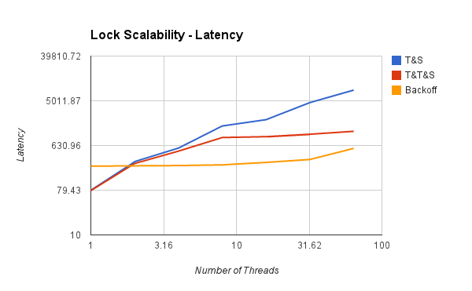
Actual Data on 40-Core Machine

Slide 84
Idea
Avoid useless invalidations
By keeping a queue of threads
Each thread
Notifies next in line
Without bothering the others
Notes:
We now explore a different approach to implementing spin locks, one that is a little more complicated than backoff locks, but inherently more portable. One can overcome these drawbacks by having threads form a line, or queue. In a queue, each thread can learn if its turn has arrived by checking whether its predecessor has been served. Invalidation traffic is reduced by having each thread spin on a different location. A queue also allows for better utilization of the critical section since there is no need to guess when to attempt to access it: each thread is notified directly by its predecessor in the queue. Finally, a queue provides first-come-first-served fairness, the same high level of fairness achieved by the Bakery algorithm. We now explore different ways to implement queue locks, a family of locking algorithms that exploit these insights.

Slide 85
Anderson Queue Lock
idle
next
flags
FREE
BUSY
BUSY
BUSY
BUSY
BUSY
BUSY
BUSY
Notes:
Here is the Anderson queue lock, a simple array-based queue lock. The threads share an atomic integer tail field, initially zero. To acquire the lock, each thread atomically increments the tail field. Call the resulting value the thread's slot. The slot is used as an index into a Boolean flag array. If flag[j] is true, then the thread with slot has permission to acquire the lock. Initially, flag[0] is true.

Slide 86
Anderson Queue Lock
idle
next
flags
FREE
BUSY
BUSY
BUSY
BUSY
BUSY
BUSY
BUSY
Notes:
Here is the Anderson queue lock, a simple array-based queue lock. The threads share an atomic integer tail field, initially zero. To acquire the lock, each thread atomically increments the tail field. Call the resulting value the thread's slot. The slot is used as an index into a Boolean flag array. If flag[j] is true, then the thread with slot has permission to acquire the lock. Initially, flag[0] is true.

Slide 87
Anderson Queue Lock
acquiring
next
getAndIncrement
flags
FREE
BUSY
BUSY
BUSY
BUSY
BUSY
BUSY
BUSY
Notes:
To acquire the lock, each thread atomically increments the tail field. Call the resulting value the thread's slot.

Slide 88
Anderson Queue Lock
acquiring
next
getAndIncrement
flags
FREE
BUSY
BUSY
BUSY
BUSY
BUSY
BUSY
BUSY

Slide 89
Anderson Queue Lock
acquired
next
Mine!
flags
FREE
BUSY
BUSY
BUSY
BUSY
BUSY
BUSY
BUSY
Notes:
The slot is used as an index into a Boolean flag array. If flag[j] is true, then the thread with slot j has permission to acquire the lock. Initially, flag[0] is true. To acquire the lock, a thread spins until the flag at its slot becomes true.

Slide 90
Anderson Queue Lock
acquired
acquiring
next
flags
FREE
BUSY
BUSY
BUSY
BUSY
BUSY
BUSY
BUSY
Notes:
Here another thread wants to acquire the lock.

Slide 91
Anderson Queue Lock
acquired
acquiring
next
getAndIncrement
flags
FREE
BUSY
BUSY
BUSY
BUSY
BUSY
BUSY
BUSY
Notes:
It applies get-and-increment to the next pointer.

Slide 92
Anderson Queue Lock
acquired
acquiring
next
getAndIncrement
flags
FREE
BUSY
BUSY
BUSY
BUSY
BUSY
BUSY
BUSY
Notes:
Advances the next pointer to acquire its own slot.

Slide 93
Anderson Queue Lock
acquired
acquiring
next
flags
FREE
BUSY
BUSY
BUSY
BUSY
BUSY
BUSY
BUSY
Notes:
Then it spins until the flag variable at that slot becomes true.

Slide 94
Anderson Queue Lock
released
acquired
next
flags
FREE
FREE
BUSY
BUSY
BUSY
BUSY
BUSY
BUSY
Notes:
The first thread releases the lock by setting the next slot to true.

Slide 95
Anderson Queue Lock
released
acquired
next
Yow!
flags
FREE
FREE
BUSY
BUSY
BUSY
BUSY
BUSY
BUSY
Notes:
The second thread notices the change, and enters its critical section.

Slide 96
Anderson Queue Lock
class ALock implements Lock {
boolean[] flags={true,false,…,false};
AtomicInteger next
= new AtomicInteger(0);
ThreadLocal<Integer> mySlot;
Notes:
Here is what the code looks like.

Slide 97
Anderson Queue Lock
class ALock implements Lock {
boolean[] flags={true,false,…,false};
AtomicInteger next
= new AtomicInteger(0);
ThreadLocal<Integer> mySlot;
One flag per thread: false is BUSY, true is FREE
Notes:
We have one flag per thread (this means we have to know how many threads there are).

Slide 98
Anderson Queue Lock
class ALock implements Lock {
boolean[] flags={true,false,…,false};
AtomicInteger next
= new AtomicInteger(0);
ThreadLocal<Integer> mySlot;
Next flag to use
Notes:
The next field tells us which flag to use.

Slide 99
Anderson Queue Lock
class ALock implements Lock {
boolean[] flags={true,false,…,false};
AtomicInteger next
= new AtomicInteger(0);
ThreadLocal<Integer> mySlot;
Thread-local variable
Notes:
Each thread has a thread-local variable that keeps track of its slot. Note: should make flags volatile so that JVM does not optimize the spin loop away on next slide. This is not consistent with JMM that requires each array entry to be volatile (which we cannot do), but it does take care of the problem.

Slide 100
Anderson Queue Lock
public lock() {
mySlot = next.getAndIncrement();
while (!flags[mySlot % n]) {};
flags[mySlot % n] = false; // BUSY
}
public unlock() {
flags[(mySlot+1) % n] = true; // FREE
}
Notes:
Here is the code for the lock and unlock methods.

Slide 101
Anderson Queue Lock
public lock() {
mySlot = next.getAndIncrement();
while (!flags[mySlot % n]) {};
flags[mySlot % n] = false; // BUSY
}
public unlock() {
flags[(mySlot+1) % n] = true; // FREE
}
Take next slot
Notes:
First, claim a slot by atomically incrementing the next field.

Slide 102
Anderson Queue Lock
public lock() {
mySlot = next.getAndIncrement();
while (!flags[mySlot % n]) {};
flags[mySlot % n] = false; // BUSY
}
public unlock() {
flags[(mySlot+1) % n] = true; // FREE
}
Spin until told to go
Notes:
Next wait until my predecessor has released the lock.

Slide 103
Anderson Queue Lock
public lock() {
mySlot = next.getAndIncrement();
while (!flags[mySlot % n]) {};
flags[mySlot % n] = false; // BUSY
}
public unlock() {
flags[(mySlot+1) % n] = true; // FREE
}
Prepare slot for re-use
Notes:
Reset my slot to false so that it can be used the next time around.

Slide 104
Anderson Queue Lock
public lock() {
mySlot = next.getAndIncrement();
while (!flags[mySlot % n]) {};
flags[mySlot % n] = false; // BUSY
}
public unlock() {
flags[(mySlot+1) % n] = true; // FREE
}
Tell next thread to go
Notes:
To release the lock, set the slot after mine to true, being careful to wrap around.

Slide 105
Local Spinning
released
acquired
next
flags
FREE
BUSY
BUSY
BUSY
BUSY
BUSY
BUSY
BUSY
Unfortunately, many bits share cache line
Notes:
Is spinning really local if multiple threads’ bits sit in the same cache line?

Slide 106
False Sharing
released
acquired
next
flags
spinning thread’s cache invalidated by unrelated store
FREE
BUSY
BUSY
BUSY
BUSY
BUSY
BUSY
BUSY
Line 1
Line 2
Notes:
False sharing occurs when a thread spinning on one bit incurs an invalidation of the line it is spinning on even though the actual bit it is interested in has not changed.

Slide 107
The Solution: Padding
released
acquired
on this
line
next
flags
FREE
/
/
/
BUSY
/
/
/
Line 1
Line 2
Notes:
To avoid false sharing each bit sits in a separate cache line.

Slide 108
Performance
TTAS
Shorter handover than backoff
Curve is practically flat
queue
Scalable performance
Notes:
The Anderson queue lock improves on Back-off locks because it reduces invalidations to a minimum and schedules access to the critical section tightly, minimizing the interval between when a lock is freed by one thread and when is acquired by another. There is also a theoretical benefit: unlike the TTAS and backoff lock, this algorithm guarantees that there is no lockout, and in fact, provides first-come-first-served fairness, which we actually loose in TTAS and TTAS with backoff.

Slide 109
Good Aspects
First truly scalable lock
Simple, easy to implement
Back to FCFS order (like Bakery)

Slide 110
Bad Aspects
Takes too much space
One bit per thread ➔ one cache line per thread
What if unknown number of threads?
What if small number of actual contenders?
Notes:
The Anderson lock has several disadvantages. First, it is not space-efficient. It requires knowing a bound N on the maximum number of concurrent threads, and it allocates an array of that size per lock. Thus, L locks will require O(LN) space even if a thread accesses only one lock at a given time. Second, the lock is poorly suited for uncached architectures, since any thread may end up spinning on any array location, and in the absence of caches, spinning on a remote location may be very expensive. Finally, even with caching one must use some form of padding to avoid false sharing which increases the space complexity further.

Slide 111
CLH Lock
FCFS order
Small, constant-size overhead per thread
Notes:
The CLH queue lock (by Travis Craig, Erik Hagersten, and Anders Landin) is much more space-efficient,
since it incurs a small constant-size overhead per thread.

Slide 112
Initially
idle
tail
tail
FREE
Notes:
This algorithm records each thread's status in a QNode object, which has a Boolean locked field. If that field is true, then the corresponding thread either has acquired the lock or is waiting for the lock. If that field is false, then the thread has released the lock. The lock itself is represented as a virtual linked list of QNodes objects. We use the term ``virtual'' because the list is implicit: each thread points to its predecessor through a thread-local pred variable. The public tail variable points to the last node in the queue.

Slide 113
Initially
idle
tail
FREE
Queue tail

Slide 114
Initially
idle
Lock is free
tail
FREE

Slide 115
Initially
idle
tail
FREE

Slide 116
Purple Wants the Lock
acquiring
tail
FREE

Slide 117
Purple Wants the Lock
acquiring
tail
FREE
BUSY
Notes:
To acquire the lock, a thread sets the locked field of its QNode to true, meaning that the thread is not ready to release the lock.

Slide 118
Purple Wants the Lock
acquiring
Swap
tail
FREE
BUSY
Notes:
The thread applies swap to the tail to make its own node the tail of the queue, simultaneously acquiring a reference to its predecessor's QNode.

Slide 119
Purple Has the Lock
acquired
tail
FREE
BUSY
Notes:
Because it sees that its predecessor’s QNode is false, this thread now has the lock.

Slide 120
Red Wants the Lock
acquired
acquiring
tail
FREE
BUSY
BUSY
Notes:
Another thread that wants the lock does the same sequence of steps …

Slide 121
Red Wants the Lock
acquired
acquiring
Swap
tail
FREE
BUSY
BUSY

Slide 122
Red Wants the Lock
acquired
acquiring
tail
FREE
BUSY
BUSY
Notes:
Notice that the list is ordered implicitly, there are no real pointers between the nodes…

Slide 123
Red Wants the Lock
acquired
acquiring
tail
FREE
BUSY
BUSY
Notes:
Notice that the list is ordered implicitly, there are no real pointers between the nodes…

Slide 124
Red Wants the Lock
acquired
acquiring
Implicit
Linked list
tail
FREE
BUSY
BUSY
Notes:
Notice that the list is ordered implicitly, there are no real pointers between the nodes…

Slide 125
Red Wants the Lock
acquired
acquiring
tail
FREE
BUSY
BUSY
Notes:
The thread then spins on the predecessor's QNode until the predecessor releases the lock.

Slide 126
Red Wants the Lock
acquired
acquiring
Actually, it
spins on locally
cached copy
BUSY
tail
FREE
BUSY
BUSY
Notes:
The thread then spins actually spins on a cached copy of purples node which is very efficient in terms of interconnect traffic.

Slide 127
Purple Releases
release
acquiring
Bingo!
FREE
tail
FREE
FREE
BUSY
Notes:
The thread then spins actually spins on a cached copy of purples node which is very efficient in terms of interconnect traffic. In fact, in some coherence protocols shared memory might not be updated at all, only the cached copy. This is very efficient.

Slide 128
Purple Releases
released
acquired
tail
BUSY
Notes:
When a thread acquires a lock it can reuses its predecessor's QNode as its new node for future lock accesses. Note that it can do so since at this point the thread's predecessor's QNode will no longer be used by the predecessor, and the thread's old QNode is pointed-to either by the thread's successor or by the tail.

Slide 129
Space Usage
Let
L = number of locks
N = number of threads
ALock: O(LN)
CLH lock: O(L+N)
Notes:
The reuse of the QNode's means that for $L$ locks, if each thread accesses at most one lock at a time, we only need O(L+N) space as compared with O(LN) for the ALock.

Slide 130
CLH Queue Lock
class QNode {
AtomicBoolean locked =
new AtomicBoolean(true);
}
Notes:
Here is what the node looks like as a Java object.

Slide 131
CLH Queue Lock
class QNode {
AtomicBoolean locked =
new AtomicBoolean(true);
}
Not released yet
Notes:
If the locked field is true, the lock has not been released yet (it may also not have been acquired yet either).

Slide 132
CLH Queue Lock
class CLHLock implements Lock {
AtomicReference<QNode> tail;
ThreadLocal<QNode> myNode
= new QNode();
public void lock() {
QNode pred
= tail.getAndSet(myNode);
while (pred.locked) {}
}}
Notes:
Here is the code for lock().

Slide 133
CLH Queue Lock
class CLHLock implements Lock {
AtomicReference<QNode> tail;
ThreadLocal<QNode> myNode
= new QNode();
public void lock() {
QNode pred
= tail.getAndSet(myNode);
while (pred.locked) {}
}}
Queue tail
Notes:
Here is the code for lock().

Slide 134
CLH Queue Lock
class CLHLock implements Lock {
AtomicReference<QNode> tail;
ThreadLocal<QNode> myNode
= new QNode();
public void lock() {
QNode pred
= tail.getAndSet(myNode);
while (pred.locked) {}
}}
Thread-local QNode
Notes:
Here is the code for lock().

Slide 135
CLH Queue Lock
class CLHLock implements Lock {
AtomicReference<QNode> tail;
ThreadLocal<QNode> myNode
= new QNode();
public void lock() {
QNode pred
= tail.getAndSet(myNode);
while (pred.locked) {}
}}
Swap in my node
Notes:
Here is the code for lock().

Slide 136
CLH Queue Lock
class CLHLock implements Lock {
AtomicReference<QNode> tail;
ThreadLocal<QNode> myNode
= new QNode();
public void lock() {
QNode pred
= tail.getAndSet(myNode);
while (pred.locked) {}
}}
Spin until predecessor
releases lock
Notes:
Here is the code for lock().

Slide 137
CLH Queue Lock
Class CLHLock implements Lock {
…
public void unlock() {
myNode.locked.set(false); // FREE
myNode = pred;
}
}

Slide 138
CLH Queue Lock
Class CLHLock implements Lock {
…
public void unlock() {
myNode.locked.set(false); // FREE
myNode = pred;
}
}
Notify successor

Slide 139
CLH Queue Lock
Class CLHLock implements Lock {
…
public void unlock() {
myNode.locked.set(false); // FREE
myNode = pred;
}
}
Recycle predecessor’s node

Slide 140
CLH Queue Lock
Class CLHLock implements Lock {
…
public void unlock() {
myNode.locked.set(false); // FREE
myNode = pred;
}
}
(we don’t actually reuse myNode. Code in book shows how it’s done.)

Slide 141
CLH Lock
Good
Lock release affects predecessor only
Small, constant-sized space
Bad
CLH lock: Doesn’t work for uncached NUMA architectures
Notes:
Like the ALock, this algorithm has each thread spin on a distinct location, so when one thread releases its lock, it invalidates its successor's cache only, and does not invalidate any other thread's cache. It does so with a lower space overhead, and, importantly, without requiring prior knowledge of the number of threads accessing a lock It also provides first-come-first-served fairness.

Slide 142
NUMA and cc-NUMA Architectures
Acronym:
Non-Uniform Memory Architecture
ccNUMA = cache coherent NUMA
Illusion:
Flat shared memory
Truth:
No caches (sometimes)
Some memory regions faster than others
Notes:
The principal disadvantage of this lock algorithm is that it performs poorly on cacheless NUMA architectures. Each thread spins waiting for its predecessor's node's to become false. If this memory location is remote, then performance will suffer. On cache-coherent architectures, however, this approach should work well.

Slide 143
NUMA Machines
Spinning on local memory is fast

Slide 144
NUMA Machines
Spinning on remote memory is slow

Slide 145
CLH Lock
Each thread spins on predecessor’s memory
Could be far away …

Slide 146
MCS Lock
FCFS order
Spin on local memory only
Small, Constant-size overhead
Notes:
The MCS lock is another kind of queue lock that ensures that processes always spin on a fixed location, so this one works well for cacheless architectures. Like the CLH lock, it uses only a small fixed-size overhead per thread.

Slide 147
Initially
idle
tail
Notes:
Here, too, the lock is represented as a linked list of QNodes, where each QNode represents either a lock holder or a thread waiting to acquire the lock. Unlike the CLH lock, the list is explicit, not virtual.

Slide 148
Acquiring
acquiring
(allocate QNode)
BUSY
tail
Notes:
To acquire the lock, a thread places its own QNode} at the tail of the list. (Notice that the
Setting of the value to true is a simplification of the presentation. In the code, we allocate the node with its value false so that we can get out of the with loop immediately if there is no predecessor. But if there is a predecessor, a thread sets the value of its flag to true before it redirects the other thread's pointer to it, so in effect its true whenever its used...thus, in order not to confuse the
viewer with the minor issue, we diverge slightly from the code and describe the node as being true here).

Slide 149
Acquiring
acquiring
swap
BUSY
tail
Notes:
The node then swaps in a reference to its own QNode.
(Notice that the
Setting of the value to true is a simplification of the presentation. In the code, we allocate the node with its value false so that we can get out of the with loop immediately if there is no predecessor. But if there is a predecessor, a thread sets the value of its flag to true before it redirects the other thread's pointer to it, so in effect its true whenever its used...thus, in order not to confuse the
viewer with the minor issue, we diverge slightly from the code and describe the node as being true here).

Slide 150
Acquired
All done, no predecessor!
acquired
BUSY
tail
Notes:
At this point the swap is completed, and the queue variable points to the tail of the queue.

Slide 151
Acquiring
acquiring
acquired
BUSY
tail
BUSY
swap

Slide 152
Acquiring
acquiring
acquired
BUSY
tail
BUSY

Slide 153
Acquiring
acquiring
acquired
BUSY
tail
BUSY

Slide 154
Acquiring
acquiring
acquired
BUSY
tail
BUSY

Slide 155
Acquiring
acquiring
acquired
BUSY
tail
true
FREE

Slide 156
Acquiring
acquiring
acquired
Yes!
BUSY
tail
FREE
true

Slide 157
MCS Queue Lock
class QNode {
volatile boolean locked = false;
volatile QNode next = null;
}
Notes:
Again, here QNode locked and next fields should be volatile so that JMM model is met and loops are not optimized away by JVM. Note that this does not appear in the code in the book.

Slide 158
MCS Queue Lock
class MCSLock implements Lock {
AtomicReference tail;
public void lock() {
QNode qnode = new QNode();
QNode pred = tail.getAndSet(qnode);
if (pred != null) {
qnode.locked = true;
pred.next = qnode;
while (qnode.locked) {}
}}}

Slide 159
MCS Queue Lock
class MCSLock implements Lock {
AtomicReference tail;
public void lock() {
QNode = new QNode();
QNode pred = tail.getAndSet(qnode);
if (pred != null) {
qnode.locked = true;
pred.next = qnode;
while (qnode.locked) {}
}}}
Make a QNode

Slide 160
MCS Queue Lock
class MCSLock implements Lock {
AtomicReference tail;
public void lock() {
QNode = new QNode();
QNode pred = tail.getAndSet(qnode);
if (pred != null) {
qnode.locked = true;
pred.next = qnode;
while (qnode.locked) {}
}}}
add my Node to the tail of queue

Slide 161
MCS Queue Lock
class MCSLock implements Lock {
AtomicReference tail;
public void lock() {
QNode = new QNode();
QNode pred = tail.getAndSet(qnode);
if (pred != null) {
qnode.locked = true;
pred.next = qnode;
while (qnode.locked) {}
}}}
Fix if queue was non-empty

Slide 162
MCS Queue Lock
class MCSLock implements Lock {
AtomicReference tail;
public void lock() {
QNode = new QNode();
QNode pred = tail.getAndSet(qnode);
if (pred != null) {
qnode.locked = true;
pred.next = qnode;
while (qnode.locked) {}
}}}
Wait until unlocked

Slide 163
Purple Release
releasing
swap
BUSY
???
Cannot release until that thread identifies its node

Slide 164
Purple Release
releasing
prepare to spin
BUSY
???

Slide 165
Purple Release
spinning
BUSY
???

Slide 166
Purple Release
releasing
spinning
FREE
true
???

Slide 167
Purple Release
releasing
Acquired lock
FREE
true
???

Slide 168
MCS Queue Unlock
class MCSLock implements Lock {
AtomicReference tail;
public void unlock() {
if (qnode.next == null) {
if (tail.CAS(qnode, null)
return;
while (qnode.next == null) {}
}
qnode.next.locked = false;
}}

Slide 169
MCS Queue Lock
class MCSLock implements Lock {
AtomicReference tail;
public void unlock() {
if (qnode.next == null) {
if (tail.CAS(qnode, null)
return;
while (qnode.next == null) {}
}
qnode.next.locked = false;
}}
Missing
successor?

Slide 170
MCS Queue Lock
class MCSLock implements Lock {
AtomicReference tail;
public void unlock() {
if (qnode.next == null) {
if (tail.CAS(qnode, null)
return;
while (qnode.next == null) {}
}
qnode.next.locked = false;
}}
If really no successor, return

Slide 171
MCS Queue Lock
class MCSLock implements Lock {
AtomicReference tail;
public void unlock() {
if (qnode.next == null) {
if (tail.CAS(qnode, null)
return;
while (qnode.next == null) {}
}
qnode.next.locked = false;
}}
Otherwise wait for successor to catch up

Slide 172
MCS Queue Lock
class MCSLock implements Lock {
AtomicReference tail;
public void unlock() {
if (qnode.next == null) {
if (tail.CAS(qnode, null)
return;
while (qnode.next == null) {}
}
qnode.next.locked = false;
}}
Pass lock to successor

Slide 173
Abortable Locks
What if you want to give up waiting for a lock?
For example
Timeout
Database transaction aborted by user
Notes:
The spin-lock constructions we have studied up till now provide first-come-first-served access with little contention, making them useful in many applications. In real-time systems, however, threads may require the ability to \emph{abort}, canceling a pending request to acquire a lock in order to meet some other real-time deadline.

Slide 174
Back-off Lock
Aborting is trivial
Just return from lock() call
Extra benefits:
No cleaning up
Wait-free
Immediate return
Notes:
Aborting a backoff lock request is trivial: if the request takes too long, simply return from the lock() method. The lock's state is unaffected by any thread's abort. A nice property of this lock is that the abort itself is immediate: it is wait-free, requiring only a constant number of steps.

Slide 175
Queue Locks
Can’t just quit
Thread in line behind will starve
Need a graceful off-ramp

Slide 176
Queue Locks
spinning
spinning
spinning
BUSY
BUSY
BUSY

Slide 177
Queue Locks
spinning
spinning
spinning
FREE
BUSY
BUSY

Slide 178
Queue Locks
locked
spinning
FREE
BUSY

Slide 179
Queue Locks
locked
FREE

Slide 180
Queue Locks
spinning
spinning
spinning
BUSY
BUSY
BUSY

Slide 181
Queue Locks
spinning
spinning
BUSY
BUSY
BUSY

Slide 182
Queue Locks
locked
spinning
FREE
BUSY
BUSY

Slide 183
Queue Locks
spinning
FREE
BUSY

Slide 184
Queue Locks
pwned
FREE
BUSY

Slide 185
Abortable CLH Lock
When a thread gives up
Removing node in a wait-free way is hard
Idea:
Let successor deal with it.
Notes:
Removing a node in a wait-free manner from the middle of the list is difficult if we want that thread to reuse its own node. Instead, the aborting thread marks the node so that the successor in the list will reuse the abandoned node, and wait for that node's predecessor.

Slide 186
Initially
idle
Pointer to predecessor (or null)
tail
A

Slide 187
Initially
idle
Distinguished available node means lock is free
tail
A

Slide 188
Acquiring
acquiring
tail
A

Slide 189
Acquiring
Null predecessor means lock not released or aborted
acquiring
A
Notes:
Each thread allocates a new QNode for each lock access. A Null predecessor value means that the QNode is not aborted and has not yet completed executing the critical section.

Slide 190
Acquiring
acquiring
Swap
A
Notes:
Each thread allocates a new QNode for each lock access. A Null predecessor value means that the QNode is not aborted and has not yet completed executing the critical section.

Slide 191
Acquiring
acquiring
A
Notes:
Each thread allocates a new QNode for each lock access. A Null predecessor value means that the QNode is not aborted and has not yet completed executing the critical section.

Slide 192
Acquired
Reference to AVAILABLE means lock is free.
locked
A
Notes:
Each thread allocates a new QNode for each lock access. A Null predecessor value means that the QNode is not aborted and has not yet completed executing the critical section.

Slide 193
Normal Case
locked
spinning
spinning
Null means lock is not free & request not aborted

Slide 194
One Thread Aborts
locked
timed out
spinning

Slide 195
Successor Notices
locked
timed out
spinning
Non-null means predecessor aborted

Slide 196
Recycle Predecessor’s Node
locked
spinning

Slide 197
Spin on Earlier Node
locked
spinning

Slide 198
Spin on Earlier Node
released
spinning
A
The lock is now mine

Slide 199
Time-out Lock
public class TOLock implements Lock {
static QNode AVAILABLE
= new QNode();
AtomicReference<QNode> tail;
ThreadLocal<QNode> myNode;

Slide 200
Time-out Lock
public class TOLock implements Lock {
static QNode AVAILABLE
= new QNode();
AtomicReference<QNode> tail;
ThreadLocal<QNode> myNode;
AVAILABLE reference means lock is free

Slide 201
Time-out Lock
public class TOLock implements Lock {
static QNode AVAILABLE
= new QNode();
AtomicReference<QNode> tail;
ThreadLocal<QNode> myNode;
Tail of the queue

Slide 202
Time-out Lock
public class TOLock implements Lock {
static QNode AVAILABLE
= new QNode();
AtomicReference<QNode> tail;
ThreadLocal<QNode> myNode;
Remember my node …

Slide 203
Time-out Lock
public boolean lock(long timeout) {
QNode = new QNode();
myNode.set(qnode);
qnode.prev = null;
QNode myPred = tail.getAndSet(qnode);
if (myPred== null
|| myPred.prev == AVAILABLE) {
return true;
}
…

Slide 204
Time-out Lock
public boolean lock(long timeout) {
QNode = new QNode();
myNode.set(qnode);
qnode.prev = null;
QNode myPred = tail.getAndSet(qnode);
if (myPred== null
|| myPred.prev == AVAILABLE) {
return true;
}
…
Create & initialize node

Slide 205
Time-out Lock
public boolean lock(long timeout) {
QNode = new QNode();
myNode.set(qnode);
qnode.prev = null;
QNode myPred = tail.getAndSet(qnode);
if (myPred== null
|| myPred.prev == AVAILABLE) {
return true;
}
…
Swap with tail

Slide 206
Time-out Lock
public boolean lock(long timeout) {
QNode qnode = new QNode();
myNode.set(qnode);
qnode.prev = null;
QNode myPred = tail.getAndSet(qnode);
if (myPred== null
|| myPred.prev == AVAILABLE) {
return true;
}
…
If predecessor absent or released, we are done

Slide 207
Time-out Lock
locked
…
long start = now();
while (now()- start < timeout) {
QNode predPred = myPred.prev;
if (predPred == AVAILABLE) {
return true;
} else if (predPred != null) {
myPred = predPred;
}
}
…

Slide 208
Time-out Lock
…
long start = now();
while (now()- start < timeout) {
QNode predPred = myPred.prev;
if (predPred == AVAILABLE) {
return true;
} else if (predPred != null) {
myPred = predPred;
}
}
…
Keep trying for a while …

Slide 209
Time-out Lock
…
long start = now();
while (now()- start < timeout) {
QNode predPred = myPred.prev;
if (predPred == AVAILABLE) {
return true;
} else if (predPred != null) {
myPred = predPred;
}
}
…
Spin on predecessor’s prev field

Slide 210
Time-out Lock
…
long start = now();
while (now()- start < timeout) {
QNode predPred = myPred.prev;
if (predPred == AVAILABLE) {
return true;
} else if (predPred != null) {
myPred = predPred;
}
}
…
Predecessor released lock

Slide 211
Time-out Lock
…
long start = now();
while (now()- start < timeout) {
QNode predPred = myPred.prev;
if (predPred == AVAILABLE) {
return true;
} else if (predPred != null) {
myPred = predPred;
}
}
…
Predecessor aborted, advance one

Slide 212
Time-out Lock
…
if (!tail.compareAndSet(qnode, myPred))
qnode.prev = myPred;
return false;
}
}
What do I do when I time out?

Slide 213
Time-out Lock
…
if (!tail.compareAndSet(qnode, myPred))
qnode.prev = myPred;
return false;
}
}
Do I have a successor?
If CAS fails, I do.
Tell it about myPred
Notes:
In case a node is timing out it first checks if tail points to its node, if

Slide 214
Time-out Lock
…
if (!tail.compareAndSet(qnode, myPred))
qnode.prev = myPred;
return false;
}
}
If CAS succeeds: no successor, simply return false
Notes:
Redirecting to predecessor tells the successors that node belongs to aborted lock() request and that they must spin on its predecessor.

Slide 215
Time-Out Unlock
public void unlock() {
QNode qnode = myNode.get();
if (!tail.compareAndSet(qnode, null))
qnode.prev = AVAILABLE;
}

Slide 216
Time-out Unlock
public void unlock() {
QNode qnode = myNode.get();
if (!tail.compareAndSet(qnode, null))
qnode.prev = AVAILABLE;
}
If CAS failed: successor exists,
notify that lock is free
Notes:
If the CAS() fails, the condition is true, there is a successor and so I must notify it what to wait on since I am timing out.

Slide 217
Timing-out Lock
public void unlock() {
QNode qnode = myNode.get();
if (!tail.compareAndSet(qnode, null))
qnode.prev = AVAILABLE;
}
CAS successful: set tail to null, no clean up since no successor waiting
Notes:
If the tail points to me, then no one is waiting and putting a null completes the unlock()

Slide 218
Fairness and NUMA Locks
MCS lock mechanics are aware of NUMA
Lock Fairness is FCFS
Is this a good fit with NUMA and Cache-coherent NUMA machines?

Slide 219
Lock Data Access in NUMA
Machine
Node 1
CS
various
memory locations
MCS
lock
Node 2
Notes:
As threads from different nodes access the data structures in the critical section, these locations bounce around the machine. True even for CC-NUMA (Cache Coherent NUMA)

Slide 220

“Who’s the Unfairest of Them All?”
locality crucial to NUMA performance
Big gains if threads from same node/cluster obtain lock consecutively
Unfairness pays
Notes:
Our own Dave and Zoran were first to notice this problem way back in 2003. Email from Sumanta indicating VOS interest in NUMA locks
Date: Sat, 23 Oct 2010 07:06:16 -0700
From: Sumanta Chatterjee <sumanta.chatterjee@oracle.com>
To: nir.shavit@oracle.com
CC: Dave Dice <dave.dice@oracle.com>
Subject: Re: Hello References
Hi Nir, I will read your paper today. Many thanks for forwarding the paper. I will take up your offer of help. We are trying to design locks that work well in NUMA. Once we have the basic design in place, we will run it by you. Thank you both. Sumanta

Slide 221
Hierarchical Backoff Lock (HBO)
Back off less for thread from same node
time
4d
2d
d
CS
Global
T&T&S
lock
Unfairness is key to performance
time
4d
2d
d
Notes:
Threads back-off exponentially, back off less if they detect that the thread in the critical section is from the same cluster.

Slide 222
Hierarchical Backoff Lock (HBO)
Advantages:
Simple, improves locality
Disadvantages:
Requires platform specific tuning
Unstable
Unfair
Continuous invalidations on shared global lock word

Slide 223
Hierarchical CLH Lock (HCLH)
Thread at local head splices local
queue into global queue
Each thread spins on cached copy of predecessor’s node
Local Tail
Local CLH queue
CAS()
Global Tail
CAS()
CS
Local Tail
Local CLH queue
CAS()
Notes:
This is a more complex scheme that implements a global MCS lock. Each thread looks at cached copy of other guys record. Spin locally! Full details of the algorithm appear in the textbook.

Slide 224
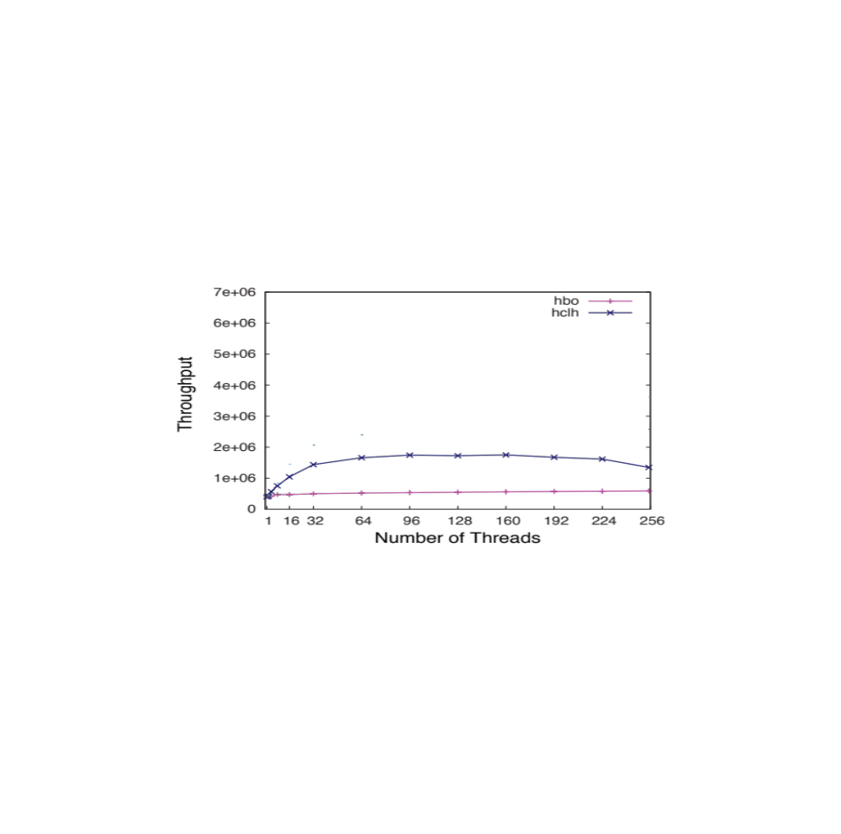
Hierarchical CLH Lock (HCLH)
HCLH
HBO
Threads access 4 cache lines in CS
Notes:
In fact, unless you tune it HBO can do far worst than MCS because of the contention

Slide 225
Hierarchical CLH Lock (HCLH)
Advantages:
Improved locality
Local spinning
Fair
Disadvantages:
Complex code implies long common path
Splicing into both local and global requires CAS
Hard to get long local sequences

Slide 226
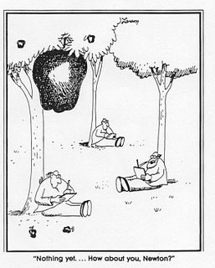
Notes:
Sometimes a simple idea is hanging right above your head but you can’t see it until you have gone through the process of designing enough complex solutions.

Slide 227
Lock Cohorting
General technique for converting almost any lock into a NUMA lock
Allows combining different lock types
But these locks must have certain properties …
Notes:
OK, but isn’t having two levels of locks going to be more expensive than having a single level?

Slide 228
Lock Cohorting
Acquire local lock and proceed to critical section
On release: if non-empty cohort of waiting threads, release only local lock; leave mark
Non-empty cohort
Local
Lock
empty cohort
Thread that acquired local lock
can now acquire global lock…
CS
Local
Lock
Global
Lock
On release: since cohort is empty must release global lock to avoid deadlock
Notes:
Sometimes it takes a whole lot of complicated ideas to get to a really simple one that was right under your nose.

Slide 229
Thread Obliviousness
A lock is thread-oblivious if
After being acquired by one thread,
Can be released by another

Slide 230
Cohort Detection
A lock x provides cohort detection if
It can tell whether a thread is trying to acquire it

Slide 231
Two Levels of Locking
Global lock: thread oblivious
Thread acquiring the lock can be different than one releasing it
Local lock: cohort detection
Thread releasing can detect if some thread is waiting to acquire it
Notes:
OK, but isn’t having two levels of locks going to be more expensive than having a single level?

Slide 232
Lock Cohorting: C-BO-MCS Lock
Two new states: acquire local and acquire global. Do we own global lock?
In MCS Lock, cohort detection by checking successor pointer
Local MCS lock tail
CAS()
Global
backoff
lock
False
False
True
Bound number of consecutive acquires to control unfairness
CS
Local MCS lock tail
time
4d
2d
d
CAS()
BO Lock is thread oblivious by definition
False
False
True
Notes:
Notice, no global tail, no splicing, utilizing low contention on global lock because.

Slide 233
Lock Cohorting: C-BO-BO Lock
How to add cohort detection property to BO lock?
Global
backoff
lock
4d
2d
d
CS
time
4d
2d
d
As noted, BO Lock is thread oblivious
4d
2d
d
Notes:
The C-BO-BO Lock
In the C-BO-BO lock, the local and global locks are both simple
BO locks. The BO lock is trivially thread-oblivious. However, we
need to augment the local BO lock to enable cohort detection by
exposing the alone? method. Specifically, to implement the alone?
method we need to add an indicator to the local BO lock that a
successor exists.
To that end we add to the lock a new successor-exists boolean
field. This field is initially false, and is set to true by a thread
immediately before it attempts to CAS the test-and-test-and-set
lock state. Once a thread succeeds in the CAS and acquires the
local lock, it writes false to the successor-exists field, effectively
resetting it. The alone? method will check the successor-exists
field, and if it is true, a successor must exist since it was set
after the reset by the local lock winner. Alone? returns the logical
complement of successor-exists.
The lock releaser uses the alone? method to determine if it can
correctly release the local lock in local release state. If it does
so, the following lock owner of the local lock implicitly inherits
ownership of the global BO lock. Otherwise, the local lock is in
the global release state, in which case, the new local lock owner
must acquire the global lock as well. Notice that it is possible that
another successor thread executing lock exists even if the field is
false, simply because the post-acquisition reset of successor-exists
by the local lock winner could have overwritten the successor’s
setting of the successor-exists field. This type of incorrect-false
result observed in successor-exists is allowed – it will at worst cause
an unnecessary release of the global lock, but not affect correctness
of the algorithm.
However, incorrect-false conditions can result in greater contention
at the global lock, which we would like to avoid. To that
end, a thread that spins on the local lock also checks the successorexists
flag, and sets it back to true if it observes that the flag has
been reset (by the current lock owner). This is likely to lead to extra
contention on the cache line containing the flag, but most of this
contention does not lie in the critical path of the lock acquisition
operation. Furthermore, intra-cluster write-sharing typically enjoys
low latency, mitigating any ill-effects of contention on cache lines
that might be modified by threads on the same cluster. These observations
are confirmed in our empirical evaluation.

Slide 234
Lock Cohorting: C-BO-BO Lock
Add successorExists field before attempting to acquire local lock.
successorExists reset on lock release.
Release might overwrite another successor’s write … but we don’t care…why?
Global
backoff
lock
4d
2d
d
CS
time
4d
2d
d
4d
2d
d
Notes:
The C-BO-BO Lock
In the C-BO-BO lock, the local and global locks are both simple
BO locks. The BO lock is trivially thread-oblivious. However, we
need to augment the local BO lock to enable cohort detection by
exposing the alone? method. Specifically, to implement the alone?
method we need to add an indicator to the local BO lock that a
successor exists.
To that end we add to the lock a new successor-exists boolean
field. This field is initially false, and is set to true by a thread
immediately before it attempts to CAS the test-and-test-and-set
lock state. Once a thread succeeds in the CAS and acquires the
local lock, it writes false to the successor-exists field, effectively
resetting it. The alone? method will check the successor-exists
field, and if it is true, a successor must exist since it was set
after the reset by the local lock winner. Alone? returns the logical
complement of successor-exists.
The lock releaser uses the alone? method to determine if it can
correctly release the local lock in local release state. If it does
so, the following lock owner of the local lock implicitly inherits
ownership of the global BO lock. Otherwise, the local lock is in
the global release state, in which case, the new local lock owner
must acquire the global lock as well. Notice that it is possible that
another successor thread executing lock exists even if the field is
false, simply because the post-acquisition reset of successor-exists
by the local lock winner could have overwritten the successor’s
setting of the successor-exists field. This type of incorrect-false
result observed in successor-exists is allowed – it will at worst cause
an unnecessary release of the global lock, but not affect correctness
of the algorithm.
However, incorrect-false conditions can result in greater contention
at the global lock, which we would like to avoid. To that
end, a thread that spins on the local lock also checks the successorexists
flag, and sets it back to true if it observes that the flag has
been reset (by the current lock owner). This is likely to lead to extra
contention on the cache line containing the flag, but most of this
contention does not lie in the critical path of the lock acquisition
operation. Furthermore, intra-cluster write-sharing typically enjoys
low latency, mitigating any ill-effects of contention on cache lines
that might be modified by threads on the same cluster. These observations
are confirmed in our empirical evaluation.

Slide 235
C-BO-BO is a Time-Out
NUMA Lock
Aborting thread resets successorExists field before leaving local lock. Spinning threads set it to true.
BO locks trivially abortable
Global
backoff
lock
4d
2d
d
CS
If releasing thread finds successorExists false, it releases global lock
time
4d
2d
d
4d
2d
d
Notes:
The A-C-BO-BO lock is very similar to the C-BO-BO lock that we
described earlier, with the difference that aborting threads also reset
the successor-exists field in the local lock to inform the local lock
releaser that a waiting thread has aborted. Each spinning thread
reads this field while spinning, and sets it in case it was recently
reset by an aborting thread. Like the C-BO-BO lock, in A-C-BOBO,
the local lock releaser checks to see if the successor-exists
flag was set (which indicates that there exist threads in the local
cluster that are spinning to acquire the lock). If the successor-exists
flag was set, the releaser can release the local BO lock by writing
release local into the BO lock.
However, at this point the releaser must double-check the
successor-exists field to determine if it was cleared during the time
the releaser released the local BO lock. If so, the releaser conservatively
assumes that there may be no other waiting cohort, and
atomically changes the local BO lock’s state to global release, and
then releases the global BO lock.

Slide 236
Time-Out NUMA Lock
Local Time-Out locks
have cohort detection property …why?
Not enough…
Local time-out queue
swap()
CS
Local time-out queue
time
4d
2d
d
swap()
Notes:
This is a more complex scheme that implements a global MCS lock. Each thread looks at cached copy of other guys record. Spin locally! Full details of the algorithm appear in the textbook.

Slide 237
Lock Cohorting
Advantages:
Great locality
Low contention on shared lock
Practically no tuning
Has whatever properties you want:
Can be more or less fair, abortable…
just choose the appropriate type of locks…
Disadvantages:
Must tune fairness parameters
Notes:
Our abortable locks 10x prior abortable locks. Disadvantages? Can’t be trained to do the dishes.

Slide 238
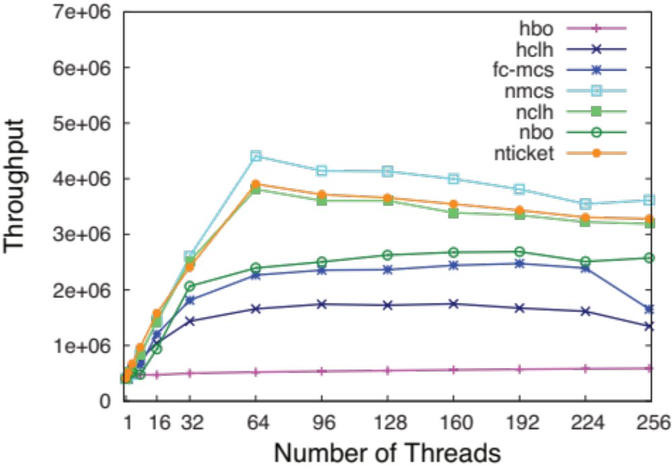
Lock Cohorting
C-BO-MCS
C-BO-BO
HCLH
HBO
Notes:
We are running in a machine with 4 nodes, 8 cores per node, each with 8 way hyper threading. So we have gone from ½ a million ops per sec to 5 million ops, a ten fold increase in performance…the FC-MCS lock in a lock using the flat combining paradigm which you will learn about in later chapters.

Slide 239
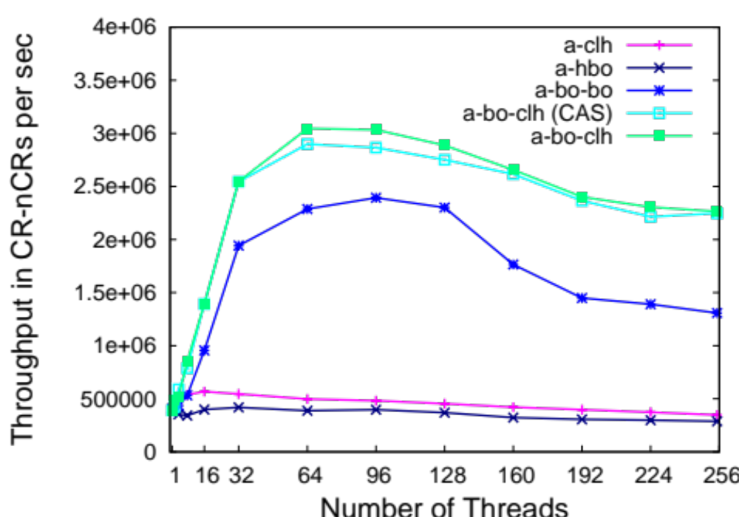
Time-Out (Abortable) Lock Cohorting
A-BO-CLH (time-out lock + BO)
A-BO-BO
Abortable CLH (our time-out lock) and HBO

Slide 240
One Lock To Rule Them All?
TTAS+Backoff, CLH, MCS, ToLock…
Each better than others in some way
There is no one solution
Best pick depends on:
the application
the hardware architecture
which properties are important
Notes:
In this lecture we saw a variety of spin locks that vary in characteristics and performance.
Such a variety is useful,
because no single algorithm is ideal for all applications.
For some applications, complex algorithms work best,
and for others, simple algorithms are preferable.
The best choice usually depends on specific aspects of the application and the
target architecture.

Slide 241
This work is licensed under a Creative Commons Attribution-ShareAlike 2.5 License.
You are free:
  to Share — to copy, distribute and transmit the work
  to Remix — to adapt the work
Under the following conditions:
  Attribution. You must attribute the work to “The Art of Multiprocessor Programming” (but not in any way that suggests that the authors endorse you or your use of the work).
  Share Alike. If you alter, transform, or build upon this work, you may distribute the resulting work only under the same, similar or a compatible license.
For any reuse or distribution, you must make clear to others the license terms of this work. The best way to do this is with a link to
  http://creativecommons.org/licenses/by-sa/3.0/.
Any of the above conditions can be waived if you get permission from the copyright holder.
Nothing in this license impairs or restricts the author's moral rights.

Slide 242
Initially
idle
tail
Notes:
Here, too, the lock is represented as a linked list of QNodes, where each QNode represents either a lock holder or a thread waiting to acquire the lock. Unlike the CLH lock, the list is explicit, not virtual.

Slide 243
Acquiring
acquiring
(allocate QNode)
BUSY
tail
Notes:
To acquire the lock, a thread places its own QNode} at the tail of the list. (Notice that the
Setting of the value to true is a simplification of the presentation. In the code, we allocate the node with its value false so that we can get out of the with loop immediately if there is no predecessor. But if there is a predecessor, a thread sets the value of its flag to true before it redirects the other thread's pointer to it, so in effect its true whenever its used...thus, in order not to confuse the
viewer with the minor issue, we diverge slightly from the code and describe the node as being true here).

Slide 244
Acquiring
acquiring
swap
BUSY
tail
Notes:
The node then swaps in a reference to its own QNode.
(Notice that the
Setting of the value to true is a simplification of the presentation. In the code, we allocate the node with its value false so that we can get out of the with loop immediately if there is no predecessor. But if there is a predecessor, a thread sets the value of its flag to true before it redirects the other thread's pointer to it, so in effect its true whenever its used...thus, in order not to confuse the
viewer with the minor issue, we diverge slightly from the code and describe the node as being true here).

Slide 245
Acquiring
acquired
BUSY
tail
Notes:
At this point the swap is completed, and the queue variable points to the tail of the queue.

